Slide 1
Cloud Login Monitoring
and Suspicious Access Alerts
Cloud Computing & Security Project
Yousef Moayyad Alkderat 20210286
Serverless login monitoring prototype using AWS
Notes:
Open by introducing the project as a cloud-based system that watches login attempts, stores them, and alerts the admin when suspicious activity is detected.

Slide 2
Problem & Goal
Why login monitoring matters for small cloud applications
Problem
Project goal
Small systems often allow logins but do not monitor risky behavior.
Repeated failed attempts and common usernames can indicate brute-force attempts.
Without logging and alerts, suspicious activity may go unnoticed.
Build a working cloud prototype for login monitoring.
Apply simple rule-based suspicious access detection.
Store login records, monitor execution, and alert the administrator.
Real use case: detect suspicious login behavior quickly
Cloud Computing & Security Project | 2
Notes:
Explain that the project solves a real security problem but keeps the implementation suitable for a student prototype using clear rules instead of machine learning.

Slide 3
Solution Overview
The end-to-end path from user login to alert
DynamoDB
records
User
Frontend
HTML page
API Gateway
/login
Lambda
analysis
CloudWatch
logs
→
→
→
→
→
↘
SNS
email alert
Frontend sends a POST request with username and password.
Lambda checks credentials and suspicious-access rules.
Results are stored, logged, and alerts are sent when needed.
Cloud Computing & Security Project | 3
Notes:
Walk through the arrows in order. Emphasize that API Gateway is the entry point, Lambda is the brain, and DynamoDB/SNS/CloudWatch provide storage, alerts, and logs.

Slide 4
Cloud Services Used
Each service has a specific role in the prototype
API Gateway
CloudWatch
Receives secure HTTPS login requests and exposes POST /login.
Keeps logs for monitoring and debugging.
AWS Lambda
SNS
Runs the backend logic and detects suspicious behavior.
Sends email alerts for suspicious logins.
DynamoDB
IAM
Stores each login attempt and detection result.
Controls permissions between services.
Advanced feature: serverless backend using AWS Lambda
Cloud Computing & Security Project | 4
Notes:
Mention that the requirement was to use three or more cloud services. This design uses six AWS services, each meaningfully integrated.

Slide 5
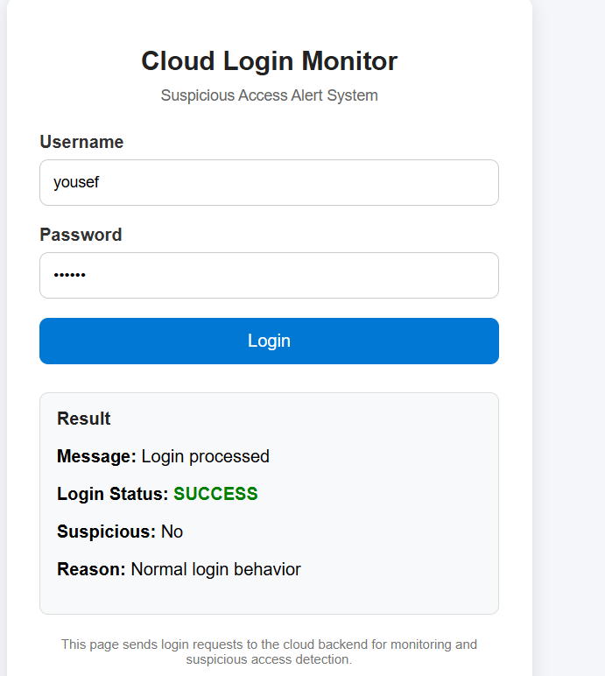
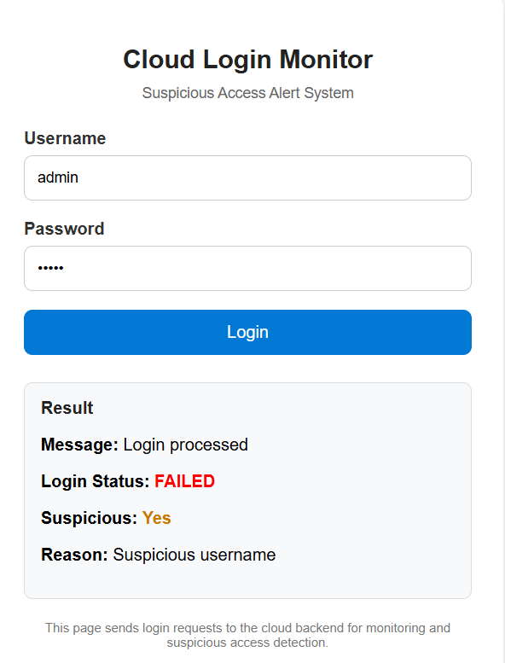
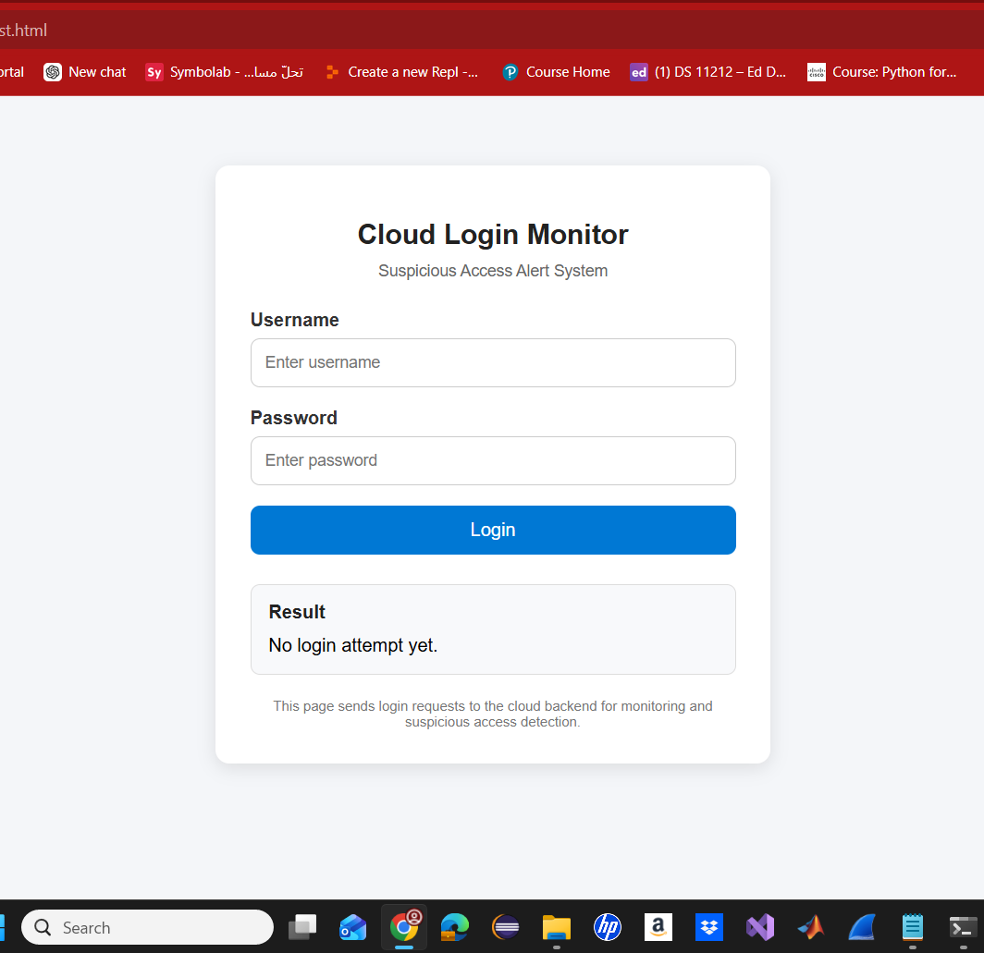
Frontend & Demo Interface
The user-facing part of the prototype
Clean login page
Normal login
Suspicious login
Cloud Computing & Security Project | 5
Notes:
Use this slide to show the interface and two important test results: a successful login and a suspicious login using the admin username.

Slide 6
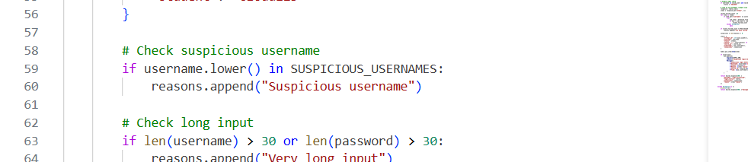
Suspicious Access Detection Rules
Simple rule-based logic used in the Lambda function
Suspicious username
Very long input
Repeated failures
Flags common risky usernames like admin, root, test, and guest.
Flags usernames or passwords longer than 30 characters.
Checks DynamoDB for 3+ failed attempts within 5 minutes.
Cloud Computing & Security Project | 6
Notes:
Explain that rule-based detection was chosen because it is transparent, low-cost, and easy to test. The screenshot shows part of the implemented Lambda logic.

Slide 7
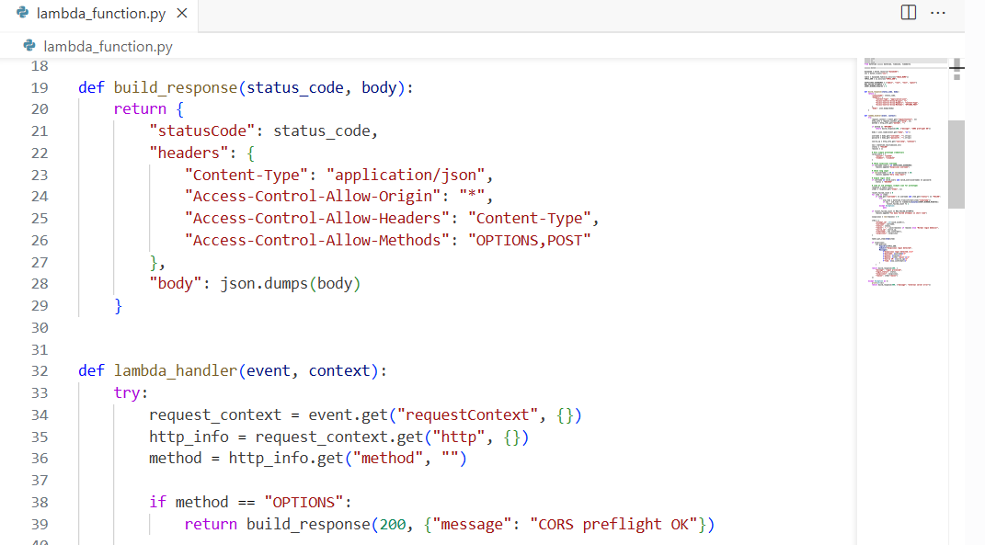
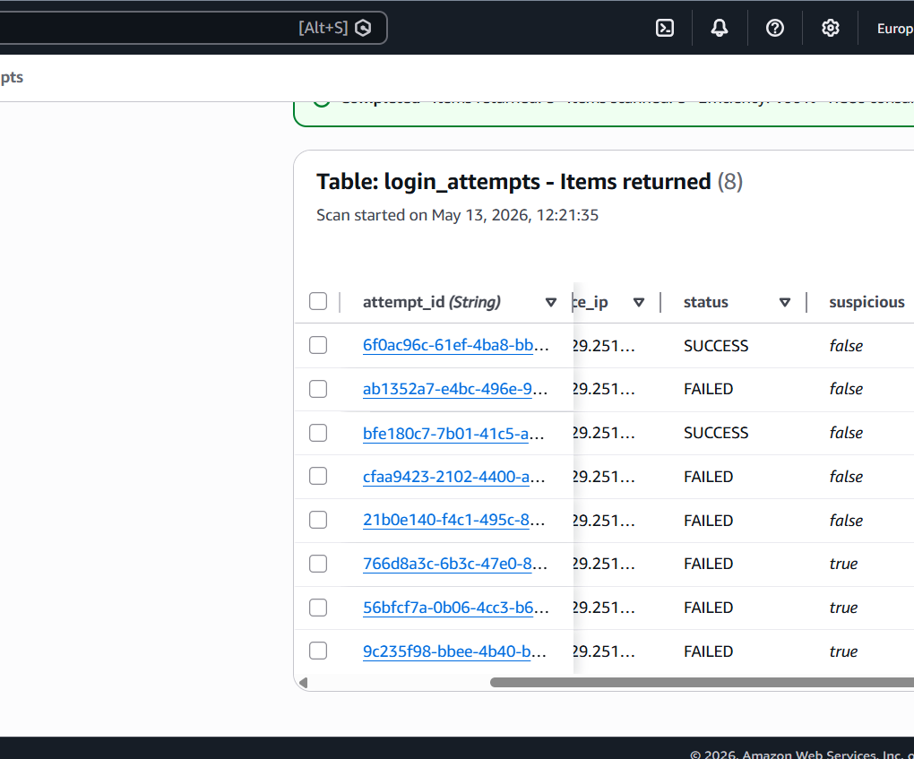
Backend Processing & Data Storage
Lambda processes the request and DynamoDB stores the result
Lambda function: request handling, CORS, and rule logic.
DynamoDB: stored login attempts with status, username, and suspicious flag.
Cloud Computing & Security Project | 7
Notes:
Show that the backend is not only returning a response, but also recording evidence in DynamoDB for later review.

Slide 8
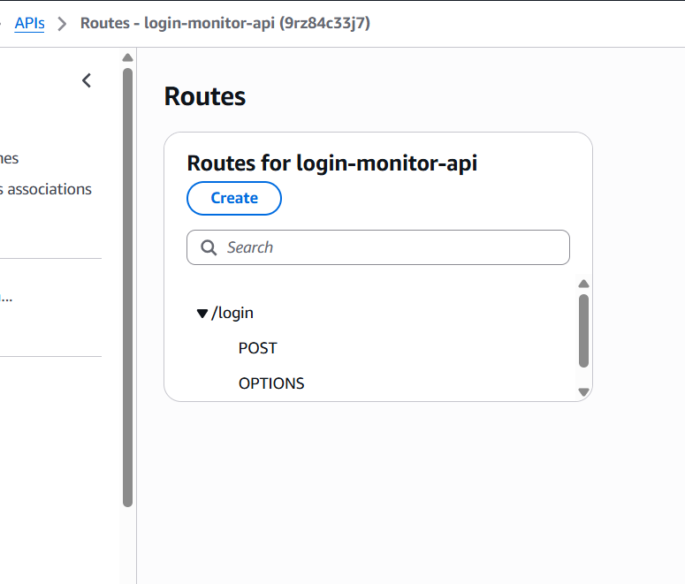
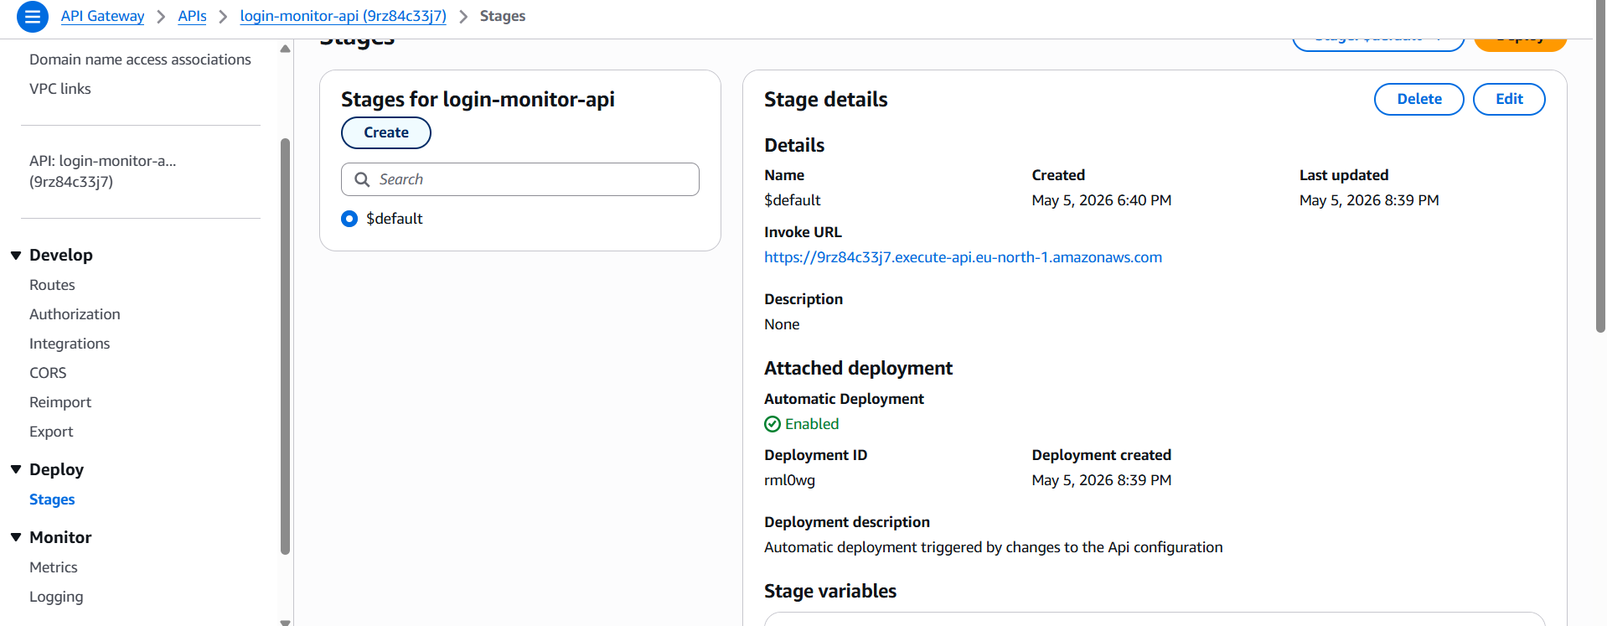
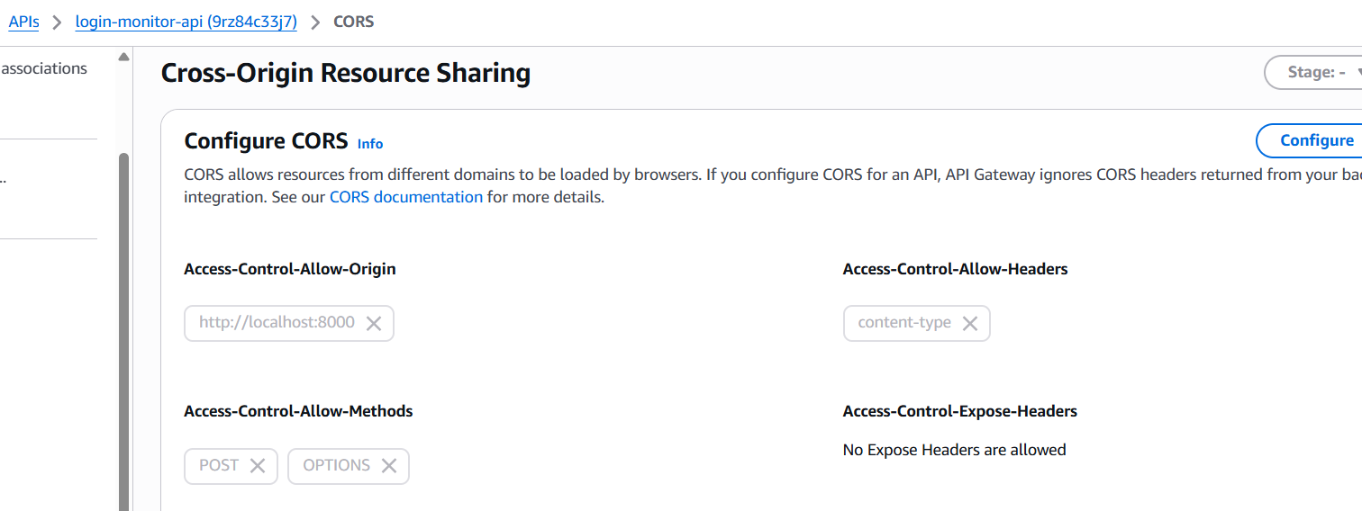
API Gateway Integration
The API entry point for the login request
POST /login handles the actual login request. OPTIONS /login handles browser CORS preflight.
Cloud Computing & Security Project | 8
Notes:
Mention the issue we solved with CORS: browser pages need permission to call the API. The OPTIONS route supports that.

Slide 9
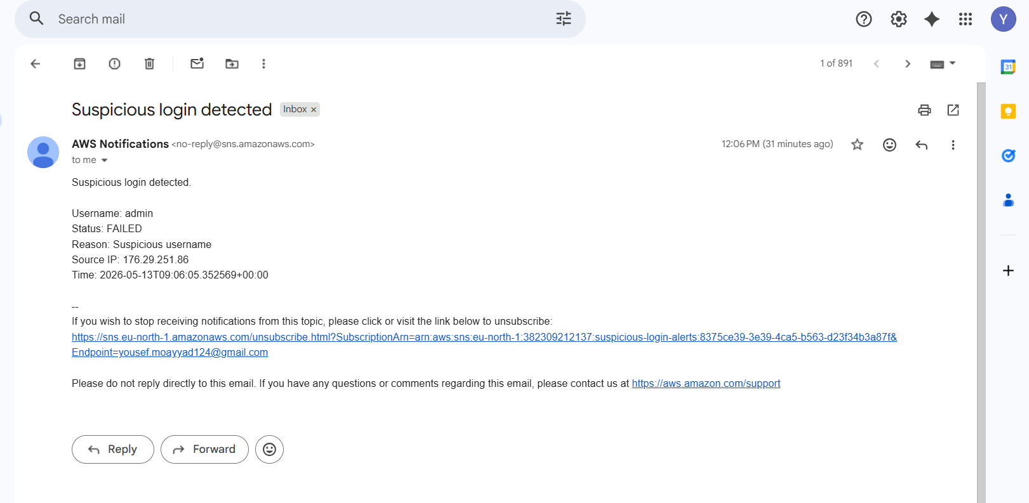
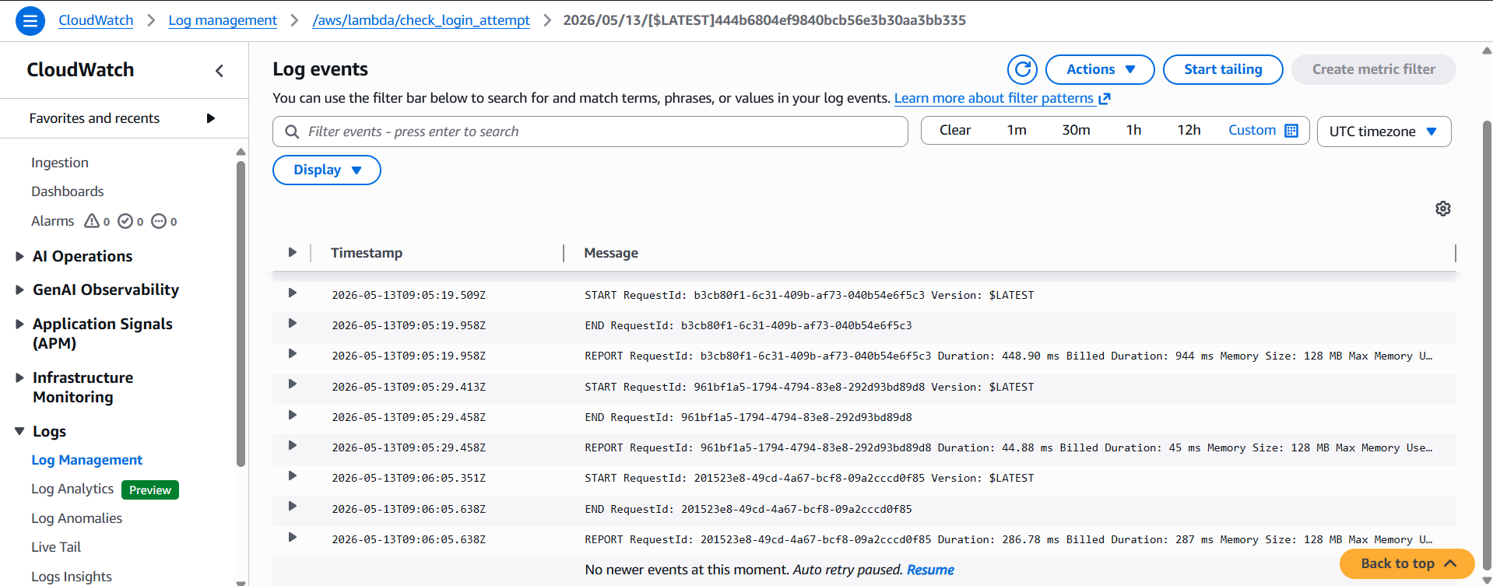
Monitoring & Alerting
CloudWatch logs activity; SNS sends alerts
SNS email alert for suspicious login
CloudWatch Lambda execution logs
Cloud Computing & Security Project | 9
Notes:
Explain how the email alert proves the suspicious login branch worked, and CloudWatch proves monitoring/logging is enabled.

Slide 10
Security Considerations
Main risks and mitigations
Threat
Mitigation
Brute-force style attempts
Rule-based detection for repeated failures and suspicious usernames
Unauthorized service access
IAM execution role with specific DynamoDB and SNS permissions
Unseen failures
CloudWatch logs for debugging and monitoring
Unencrypted web traffic
API Gateway HTTPS endpoint
Admin not notified
SNS email alert for suspicious behavior
Cloud Computing & Security Project | 10
Notes:
Tie security back to the grading rubric: IAM, secure communication, monitoring, and alerting are all included and explained.

Slide 11
Testing & Results
Main test cases used to verify the prototype
Test case
Input
Expected result
Actual result
Normal login
yousef / 123456
SUCCESS, not suspicious
Passed
Suspicious username
admin / wrong
FAILED, suspicious
Passed
DynamoDB storage
Any login attempt
Record saved
Passed
SNS alert
Suspicious login
Email sent
Passed
CloudWatch logging
Lambda invocation
Logs generated
Passed
End-to-end flow verified: frontend → API Gateway → Lambda → DynamoDB / SNS / CloudWatch
Cloud Computing & Security Project | 11
Notes:
Mention that the screenshots in the report provide proof for these test results.

Slide 12
Conclusion & Demo Path
What was achieved and what can be improved
What was achieved
Future improvements
Built a working cloud security prototype.
Used multiple AWS services in an integrated design.
Detected suspicious login behavior and sent email alerts.
Stored records and monitored execution logs.
Add real authentication and password hashing.
Improve detection using IP-based rate limiting.
Deploy the frontend publicly instead of localhost.
Add Docker or CI/CD for a more complete DevOps workflow.
Demo
Cloud Computing & Security Project | 12
Notes:
End with a clear summary and then move to the live demo. Explain the future improvements honestly, including Docker as a possible next step.

